Slide 1
Section 2.5
Combining Transformations Together
© Copyright All Rights Reserved Homework Depot www.BCMath.ca

Slide 2

Multiple Transformations:
When multiple transformations are present, there are two ways to perform them
Method 1: Factor and then read them from left to right
constant “a” indicates whether it will be a vertical expansion/compression/ or reflection
constant “b” indicates whether it will be a horizontal expansion/compression/or reflection
C
E
E
C
constant “c” indicates whether it will be a horizontal shift of left or right
constant “d” indicates whether it will be a vertical shift of UP or Down

Slide 3
To use the factoring method, make sure that the coefficient of the “x” and “y” variables is equal to one by factoring out the coefficient
When an equation is written in the “factored” form, the transformations can be read from “left” to “right”
V.E. by a
factor of 3
H.C. by a
factor of ½
H.S. by 5
units left
V.S. by 8
units down

Slide 4
Practice: Indicate the Transformation in order
H.C. by a factor of ½
H. Shifted 4
units Right
V.E. by a
factor of 2
Horizontal
compression by a factor of 1/3
Horizontal
Shift of 3
units right
Vertical Shift
of 2 units up
Vertical
Reflection!!
© Copyright All Rights Reserved Homework Depot www.BCMath.ca

Slide 5


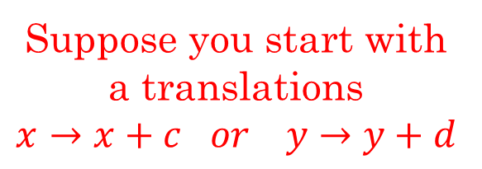


Method #2 Circling Method: Circle the “x” or “y” variables and then indicate how these variables are affected in steps
The transformations can then be performed in any order that you prefer
You can start off with either a Exp/Comp OR a translation
$$y→ay$$
V.E. or V.C.
Suppose you start with a translations
$$x→x+c or y→y+d$$
If you perform a translations
after your equation will become:
Now if you perform a H.E/C or V.E/C afterwards, your equation will become:
$$y→y+d$$
$$y→ay$$
$$x→bx$$
The “y+d” will be in brackets and both value will be multiplied by “a”
Only the “x” & “y” variables are multiplied by the constants “a” and “b”

Slide 6


Practice: Indicate the transformations in Order
HS 9 left and VS 6 up
V.R. over the x-axis and
also a V.E. by $\frac{3}{2}$
H.R. over the y-axis and
also a H.C. by $\frac{1}{3}$
© Copyright All Rights Reserved Homework Depot www.BCMath.ca

Slide 8

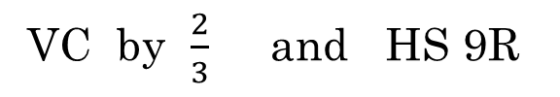
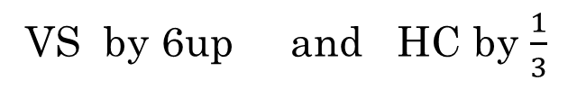
Practice: Given that the coordinates (2d,3e) is on $y=f(x)$, what will the coordinates be after the following transformations?
Method 1
Method 2
VC by $\frac{2}{3}$ and HS 9R
V.C. by a factor of 2/3
H.C. by a factor of 1/3
VS by 6up and HC by $\frac{1}{3}$
H.S. 3 units right
V.S. 6 units up
© Copyright All Rights Reserved Homework Depot www.BCMath.ca

Slide 9
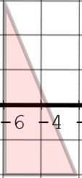
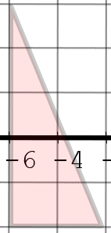
The order of the transformation doesn’t matter as long as the final formula suits what you want!
Ex: Given the two sets of transformations, will they yield the same outcome?
Transformations 1) Horizontal Reflection and then a horizontal shift of 3 units right
Transformations 2) Horizontal shift of 3 units left and then a Horizontal Reflection
Horizontal Reflection
Horizontal Shift 3 Left
Horizontal Shift 3 right
Horizontal Reflection
y
y
8
8
6
6
4
4
2
The two sets of transformations will yield the same outcome!!!
2
x
x
-8
-6
-4
-2
0
2
4
6
8
-8
-6
-4
-2
0
2
4
6
8
-2
-2
-4
-4
-6
-6
-8
-8

Slide 10
Ex: Given that the coordinates (a,b) is on the original function, find the coordinates after the transformation
Initial Coordinate:
V.C. by a factor of ½
Multiply all y-coordinates by ½
H.C. by a factor of ½
Multiply all x-coordinates by ½
V. Shift of 4 units up
Add 4 units to all y-coordinates
© Copyright All Rights Reserved Homework Depot www.BCMath.ca

Slide 11
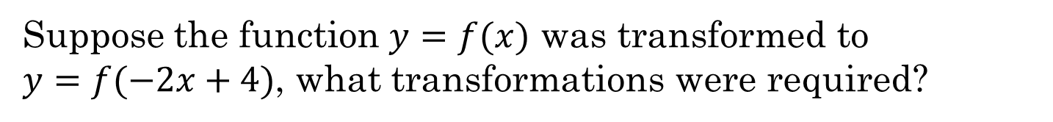
Suppose the function $y=f(x)$ was transformed to
$y=f(−2x+4)$, what transformations were required?
a) 1st: Horizontal Reflection & Compression by factor of ½
2nd: Horizontal shift of 4 units right
b) 1st: Horizontal Reflection & Compression by factor of
2nd: Horizontal shift of 4 units left
c) 1st: Horizontal Reflection & Compression by factor of ½
2nd: Horizontal shift of 2 units right
d) 1st: Horizontal shift of 4 units left
2nd: Horizontal Reflection & Compression by ½
e) 1st: Horizontal shift of 4 units right
2nd: Horizontal Reflection & Compression by ½

Slide 12
Given the circle, which graph represents the transformation shown in the equation?
y
A)
C)
8
6
y
y
8
8
4
6
6
2
x
4
4
-8
-6
-4
-2
0
2
4
6
8
2
2
-2
x
x
-4
-8
-6
-4
-2
0
2
4
6
8
-8
-6
-4
-2
0
2
4
6
8
-2
-2
-6
-4
-4
-8
-6
-6
-8
-8
B)
D)
y
y
8
8
6
6
4
4
2
2
x
x
-8
-6
-4
-2
0
2
4
6
8
-8
-6
-4
-2
0
2
4
6
8
-2
-2
-4
-4
-6
-6
-8
-8

Slide 13
Ex: Given the graphical transformation, which equation represents it?
y
y
8
8
6
6
4
4
2
x
2
x
-8
-6
-4
-2
0
2
4
6
8
-8
-6
-4
-2
0
2
4
6
8
-2
-2
-4
-4
-6
-6
-8
-8

Slide 14
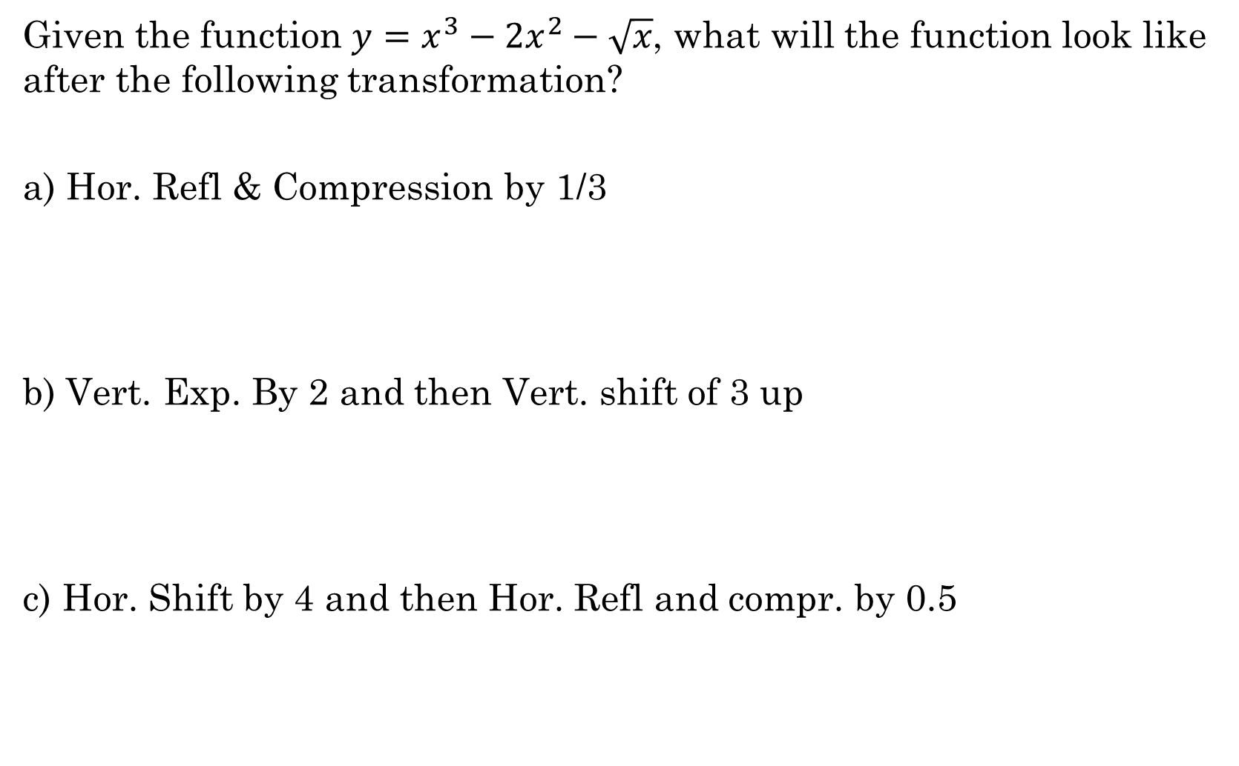
Given the function $y=x^{3}−{2x}^{2}−\sqrt{x}$, what will the function look like after the following transformation?
a) Hor. Refl & Compression by 1/3
b) Vert. Exp. By 2 and then Vert. shift of 3 up
c) Hor. Shift by 4 and then Hor. Refl and compr. by 0.5

Slide 15
Ex: Given the graph of y= f(x), draw the graph for
Factor the equation!!
y
VC by a factor of ½
8
6
HC by a factor of ½
4
2
x
HS of 2 units right!!
-8
-6
-4
-2
0
2
4
6
8
-2
-4
VS 3 units UP!!
-6
-8
© Copyright All Rights Reserved Homework Depot www.BCMath.ca

Slide 16
II) Reading Transformations from Left to Right:
Horizontal
Expansion or
Compression
Horizontal
Shift: Left or
Right
Vertical
Expansion or
Compression
Original
Function
Vertical Shift:
Up or Down
Isolate “y”
Variable!!
General Rule: Most Transformation are performed in the
order from LEFT to RIGHT!
C
E
E
C
First do all
V.R./V.E./V.C.
Next all the
HR/HE/HC
Then all the
H.S. (Left/Right)
Finally the V.S.
(Up/Down)
Shift 3 units left
Shift 3 units right
Shift 4 units down
Shift 4 units up
© Copyright All Rights Reserved Homework Depot www.BCMath.ca

